Slide 1

EMBEDDED SYSTEM DESIGN & IoT
DAY 1
Master Class

Slide 2
Why 30 Days Challenge?
SKILL SET + MINDSET

Slide 3
What you will Learn? –Week 1
Day 1- Introduction to Embedded System Design and IoT
Day 2 -Choosing the Right Processor and Embedded Product Life cycle .
Day 3-Challenges and Design Issues in Embedded Systems, Assemblers, Compilers, Linkers, Loaders, Debuggers, Embedded In-Circuit Emulators & JTAG, Profilers and Test Coverage Tools, Build Tools for Embedded Systems.
Day 4-Introduction to Real-Time Concepts.
Day 5- Introduction to IoT, IoT Trends, IoT Architecture, IoT Applications, IoT Standards and Protocols,

Slide 4
What you will Learn? –Week 2 -8051
Day 6- 8051 Architecture-Keil
Day 7 –Interfacing Switch ,Relay with 8051
Day 8-UART and SPI
Day 9-LCD and IIC
Day 10- 8051 Mini Project –Bluetooth Based Home Automation

Slide 5
What you will Learn? –Week 3 -ARM
Day 11 -ARM Architecture-Keil
Day 12 –Interfacing Switch ,Relay with ARM
Day 13 -UART and SPI
Day 14 -LCD and IIC
Day 15 -ARM Mini Project –IoT Based Weather Monitoring System

Slide 6
What you will Learn? –Week 4-Cortex M4
Day 16 -CORTEXM4 LPC4088 Architecture-Keil, LED Blinking
Day 17 –Interfacing Switch ,Relay with ARM
Day 18 -UART and SPI
Day 19 -LCD and IIC
Day 20 - CORTEXM4 Mini Project –Temperature Monitoring System using Zigbee and LORA

Slide 7
What you will Learn? –Week 5-PIC
Day 21 - Introduction to PIC Architecture
Day 22 –MPLAB IDE and LED Blinking, Switch and relay
Day 23 -UART and SPI
Day 24 -LCD and IIC
Day 25 -PIC Mini Project – PWM based Motor control

Slide 8
What you will Learn? –Week 6-NODE MCU
Day 26 - Introduction to NODE MCU
Day 27 –Led,switch,relay,UART
Day 28 -IoT Temperature Data Logging
Day 29 -Build Your Home Automation with ESP8266 and Control Devices from Anywhere in the World
Day 30 -Conclusion and Wrap up-Graduation Day

Slide 9
Sequel Program
Embedded Product Design (Aug 9-Aug 28)
Schematic Design and Layout Design using Altium
Design and Manufacture your Own Arduino Board
AI for Embedded Processors (Nvidia)

Slide 10
About Pantech
Started in the Year 2004
Lab equipments and Sensor Interface
Manufacturer of Brainsense EEG Headset
Reconfigurable Algorithms on AI
Manufacture of AI development Boards
Power electronics, Fuel cell and Renewable Energy trainers
www.pantechsolutions.net

Slide 11

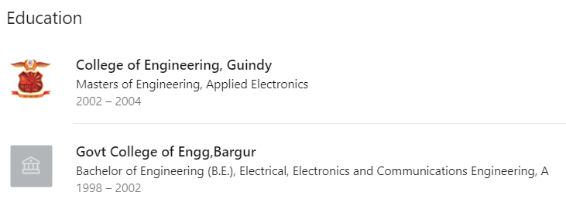
About me
My Primary Expertise
Microcontroller Architecture: 8051,PIC,AVR,ARM,MSP430,PSOC3 DSP Architecture: Blackfin,C2000,C6000,21065L Sharc FPGA: Spartan,Virtex,Cyclone Image Processing Algorithms: Image/Scene Recognition, Machine Learning, Computer Vision, Deep Learning, Pattern Recognition, Object Classification ,Image Retrieval, Image enhancement and denoising. Neural Networks : SVM,RBF,BPN Cryptography :RSA,DES,3DES,Ellipti curve,Blowfish,Diffe Hellman Compilers: Keil,Visual DSP++,CCS, Xilinx Platform studio,ISE, Matlab, Open CV
https://www.linkedin.com/in/jeevarajan/
www.pantechsolutions.net

Slide 12
Announcement
Attendance Link at 9 pm
Minimum attendance required for an E-Certificate is 27 Days. Attendance link will be valid for 1 hrs. after the event.
For Internship Candidates no attendance required ,it will be accessed from the LMS Portal. (learn.pantechsolutions.net)
Recorded Video Streaming for LAB classes to improve Learning Experience
support.pantechsolutions.net

Slide 13
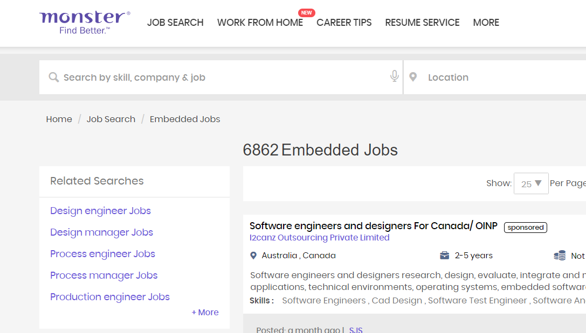
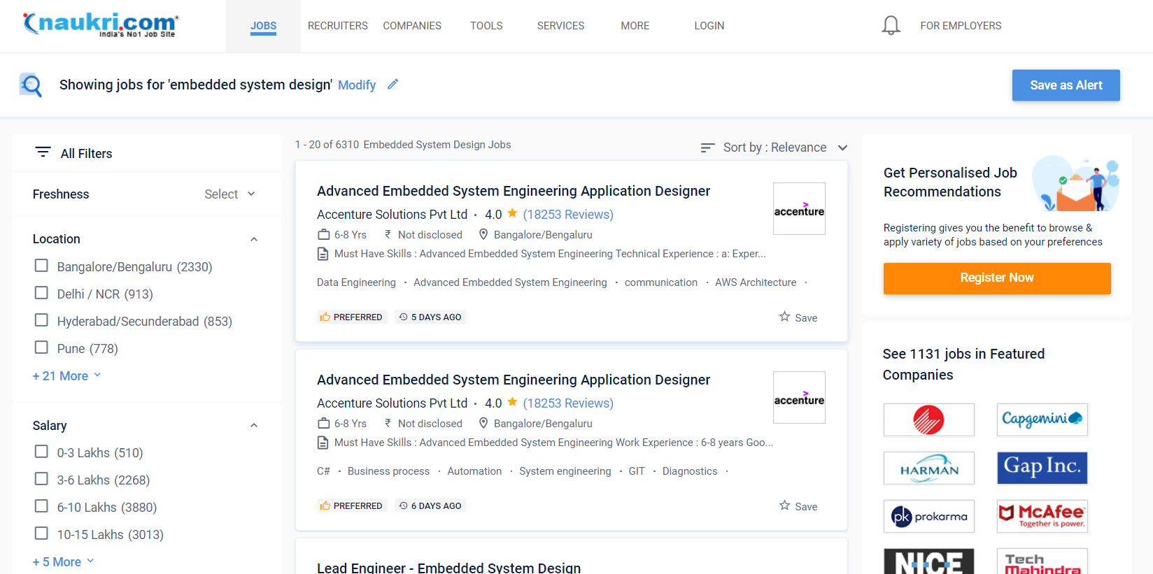
Job Opportunities in Embedded System design

Slide 14
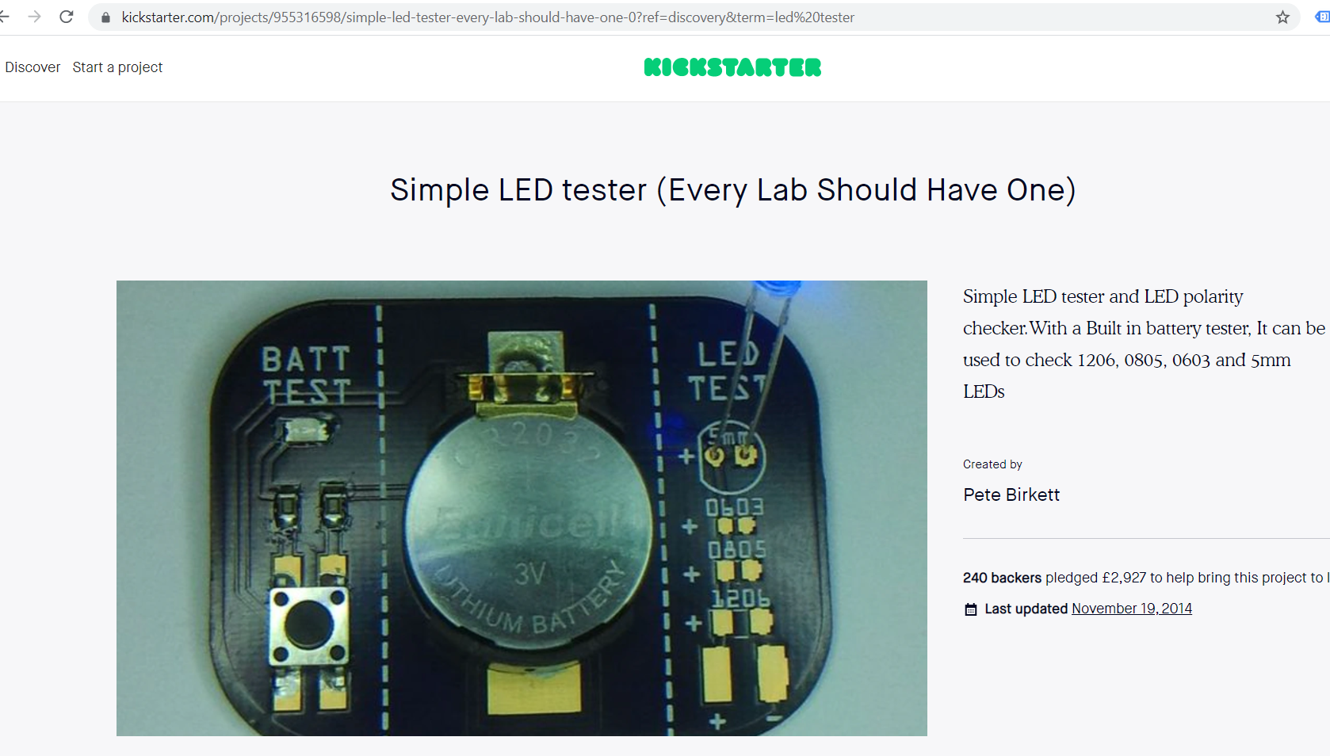
How to Earn Money on Embedded system design via crowdfunding
https://www.indiegogo.com/projects/rivicamer-the-next-generation-5k-portable-scanner#/
https://www.crowdsupply.com/radiona/ulx3s

Slide 15
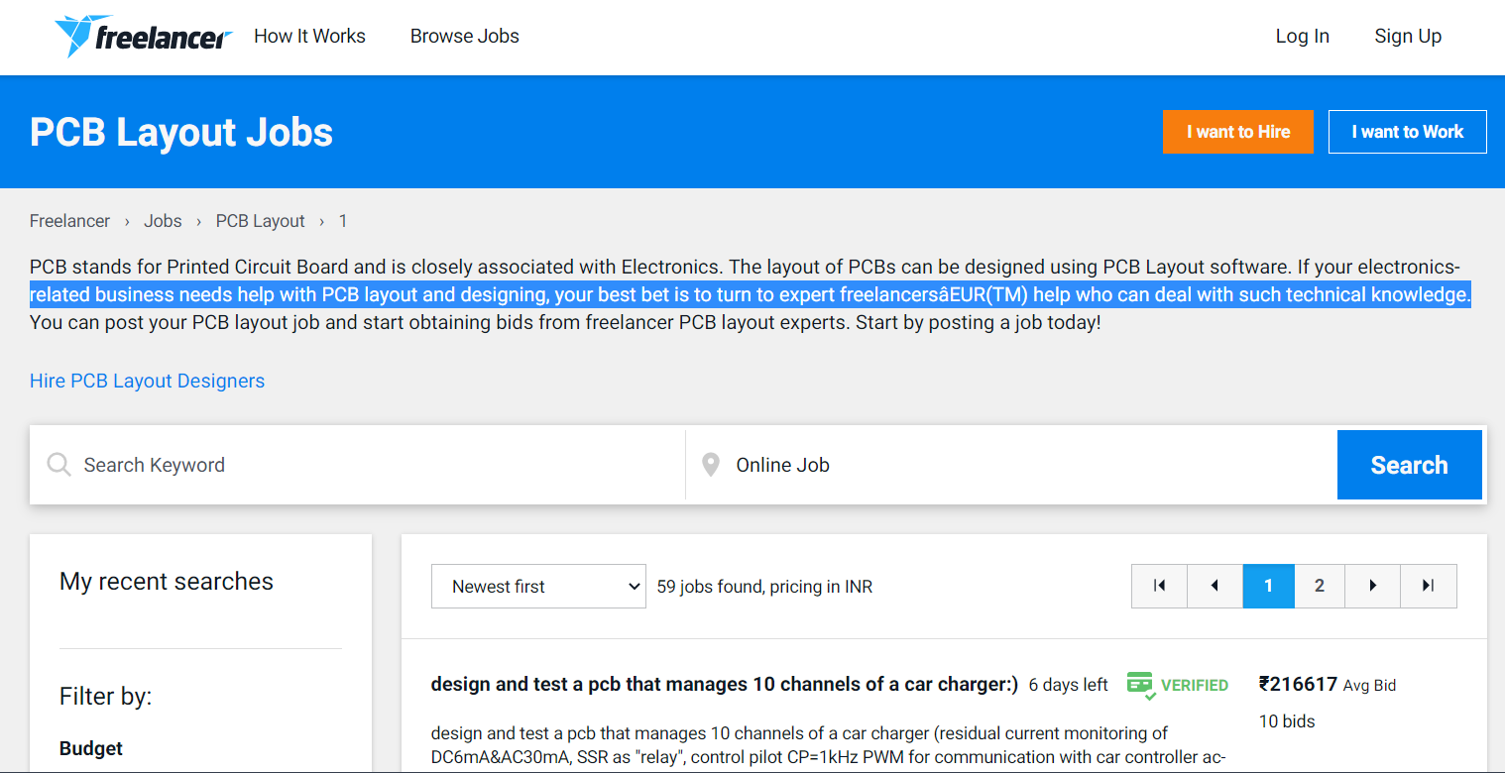
Freelancer in Embedded system design
https://www.freelancer.in/jobs/pcb-layout/

Slide 16
Day 1 Introduction to Embeded Design and IoT

Slide 17

Mindset Lesson for the Day
Have a Definite Goal . Goal without Deadline is a dream.
Prepare a Goal Card

Slide 18
What is Embedded System
It is a Combination of Both Hardware and Software with some mechanical parts to perform a Specific task is called Embedded System
Desktop Vs Embedded System
Eg: printer

Slide 19
Classification of Embedded System
Stand alone Embedded System
Real Time Embedded System
Hard real time
Soft Real time
Network embedded system
Mobile Embedded System

Slide 20
Types of Processors and Controllers for Embedded System Design
Mp/Mc
DSP
CPLD/FPGA
ASIC
SOC

Slide 21
What Language you can choose for embedded system
ASM
C
Mixed C/ASM
Python
HDL

Slide 22
List of Companies dominating processor Manufacturing
Texa Instruments
Analog Devices
Intel ,NVidia
Broadcom /QUALCOMM/Mediatek
Microchip/NXP/Renesas
Lattice/Xilinx/Altera(Intel)

Slide 23
Applications
Aerospace
Automotive infotainment
Smart home
Industry 4.0 Automation
Robotics
Communication
Audio ,Video and
Medical Imaging

Slide 24
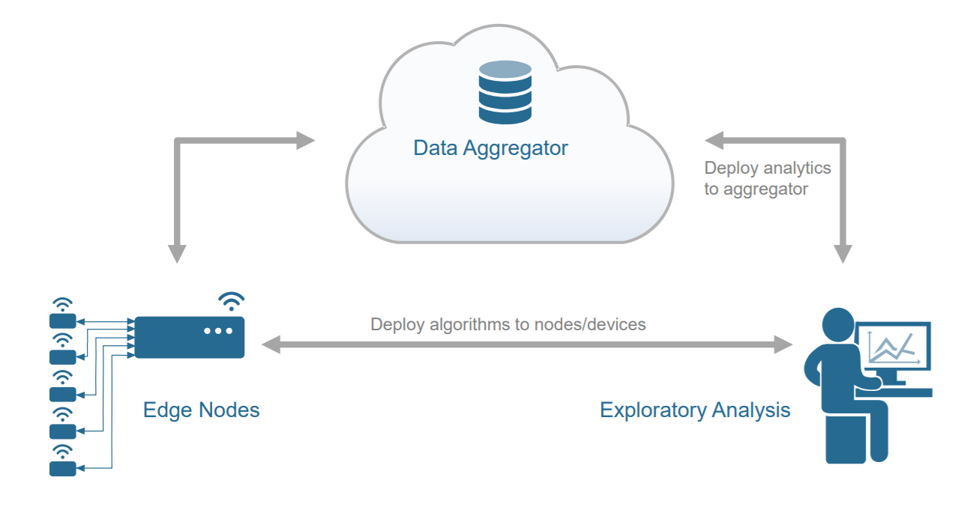
What is Internet of Things

Slide 25
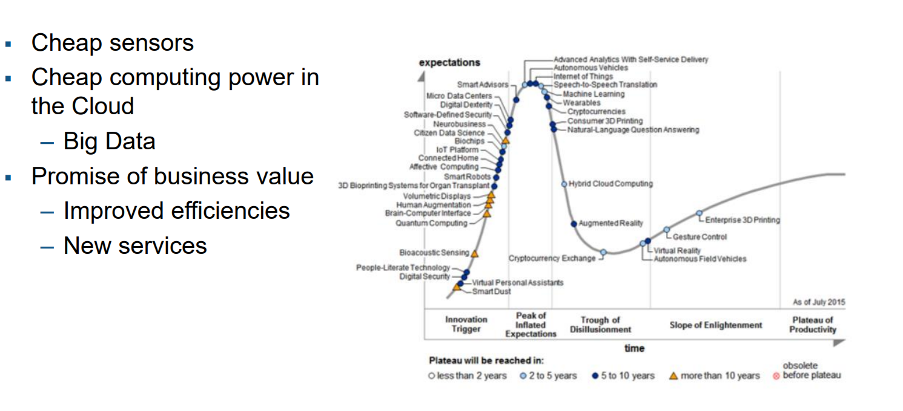
Trends Driving IoT

Slide 26
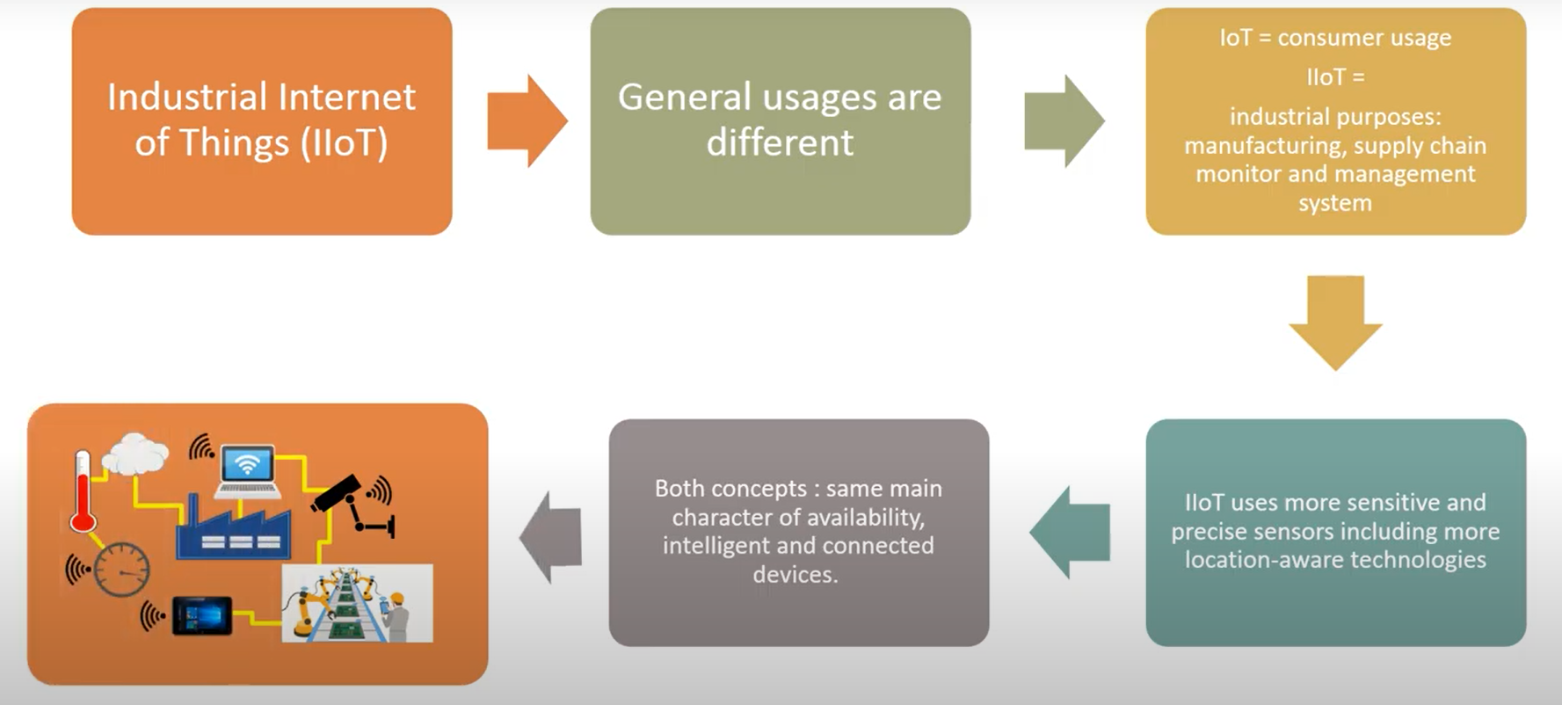
What is Industrial IoT

Slide 27
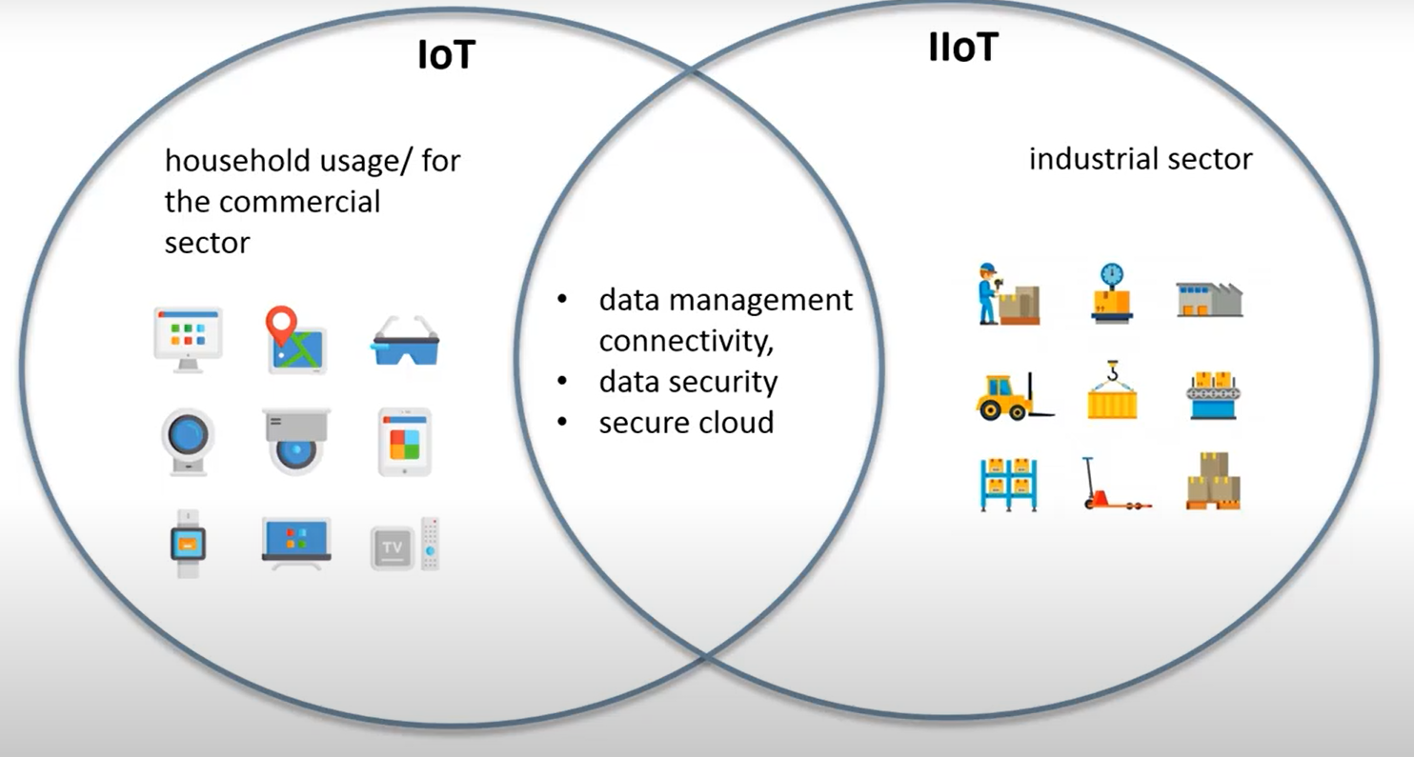
IoT vs IIOT

Slide 28
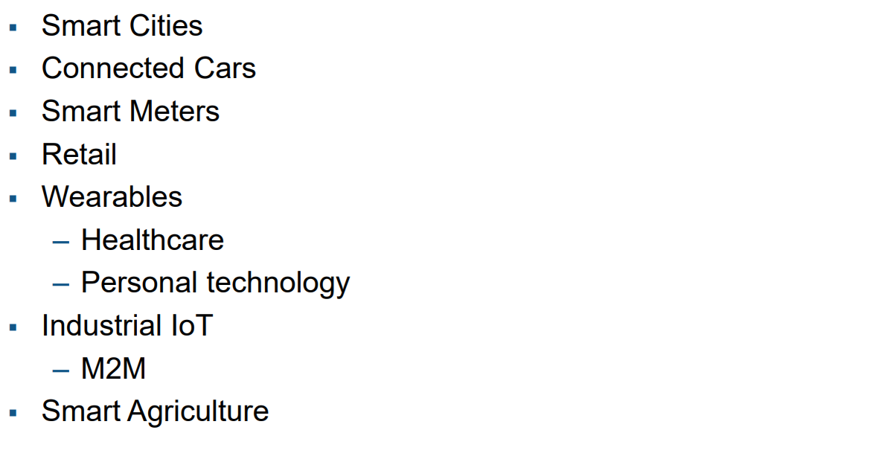
Markets Driven by IoT

Slide 29
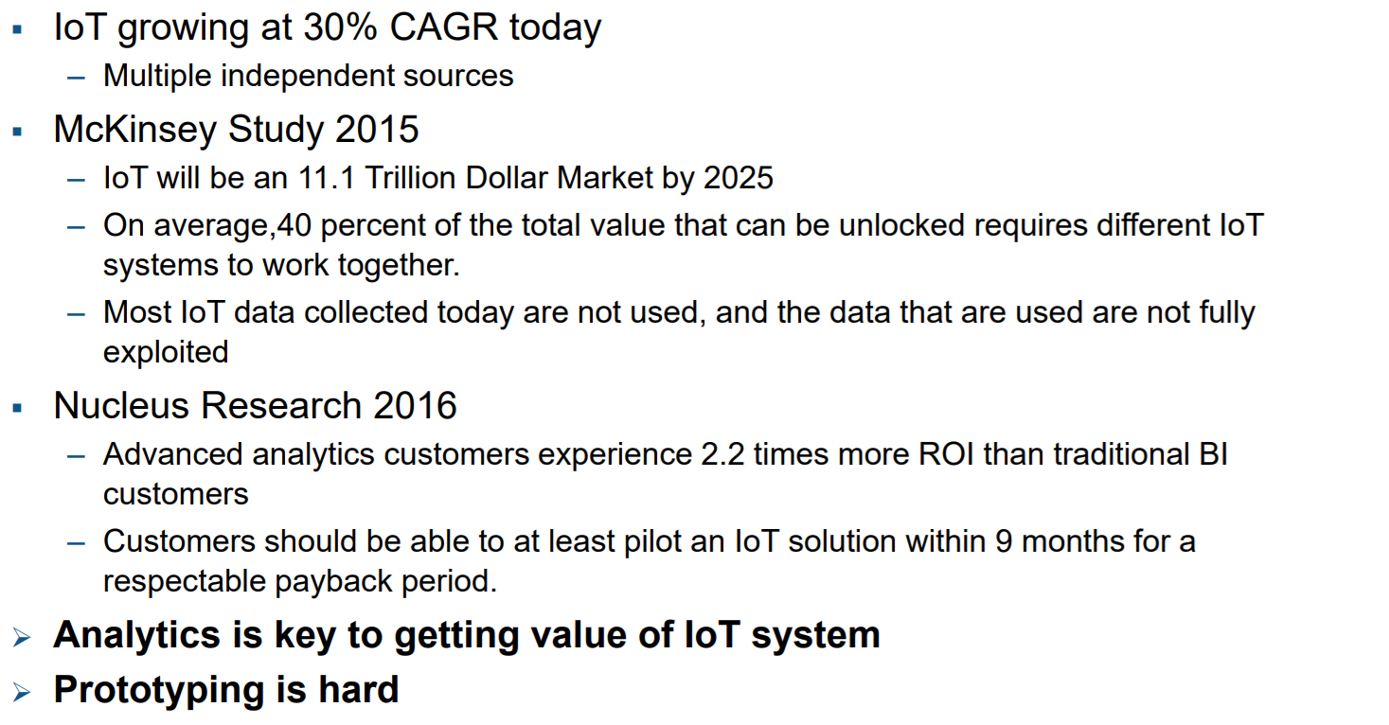
Market Situation

Slide 30
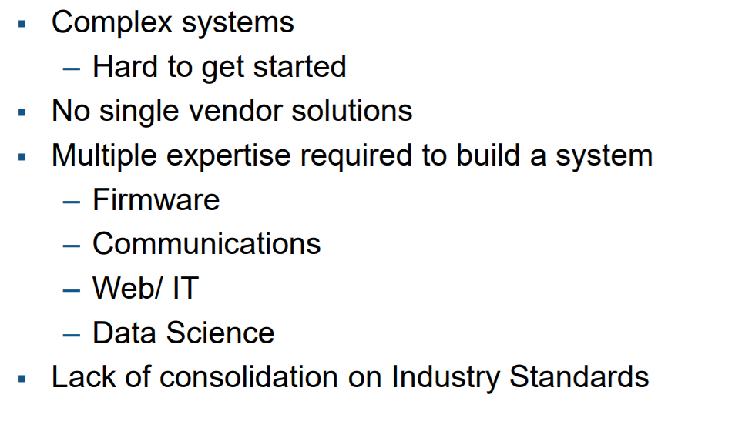
Challenges of IoT

Slide 31
List of Cloud
Thing speak
Amazon Web Service
Microsoft Azure
Google Cloud

Slide 32
How to convert an Idea to a Prototype
Choose the Right processor
Choose the Development tool
Does the application need an RTOS or a simple program
Choose your packages and production tool
Schematic Design, Consider (DFT)(DFM)
Layout Design
Assembling ,Debugging and Testing
Enclosure Design
Plan for certification if required,
Design of Test jig for Mass Production

Slide 33
Embedded Development Life Cycle
RTOSs
Networking Protocols
Graphics Support
Memory Leak Detection
Compiler
Java Support
Project & Code Mgmt.
Rapid Prototyping
Real-time Data Visualization
Post-mortem Debug
RTOS Simulation
CPU
Profiling
SW SELECTION
SW DEVELOPMENT
INTEGRATION
TESTING & TUNING
DEPLOYMENT
HW SELECTION
HW DEVELOPMENT
Real-time System Analysis & Triggering
Execution Tracing
In-field Debugging
Source-level Debugging
Code Coverage Analysis
Board Diagnostics & Manufacturing Test
Board Bring-Up
Semiconductor Co-funded Development
Hardware Coverage
© 2008 Pantech Solutions™ | All rights reserved

Slide 34
Recap of Designing an Embedded System
Choose Idea
Decide application, Features,
cost of the product
Select the right processor
and packages
C/ASM/GRAPHICAL
Design and fabricate PCB
Components Assembly
Integration
Testing

Slide 35
Thank You

